Slide 1
Appendix B
Turbo Pre and Post
Introduction to CFX

Slide 2
Turbo Pre

Slide 3
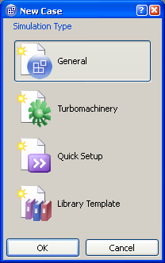
CFX-Pre Turbo Mode
Turbo mode in ANSYS CFX-Pre is a specialist mode allowing users to set up turbo machinery simulations, such as compressors or turbines, in a simple manner.

Slide 4
CFX-Pre Turbo Mode
At any time, users can enter turbo mode from the file menu
  Tools > Turbo Mode
Buttons at bottom to navigate through the wizard:
  Next – move to the next page
  Back – move to the previous page
  Finish – any data that has been entered will be committed, Pre goes into General Mode
  Cancel – close Turbo mode and revert to General Mode
    Meshes will remain, data will not

Slide 5
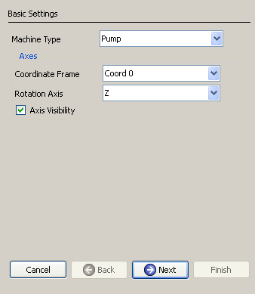
CFX-Pre Turbo Mode
Basic Settings
  setup axis of rotation and coordinate frame

Slide 6
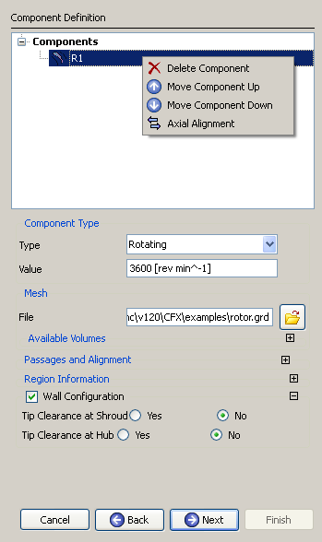

CFX-Pre Turbo Mode
Component Definition
  Import meshes (right-click)
  Define rotating or stationary
    Define rotational speed
  Define number of passages
  Define tip clearance if applicable
  For multiple stages, use right click to:
    Change component order
    Automatically align components

Slide 7
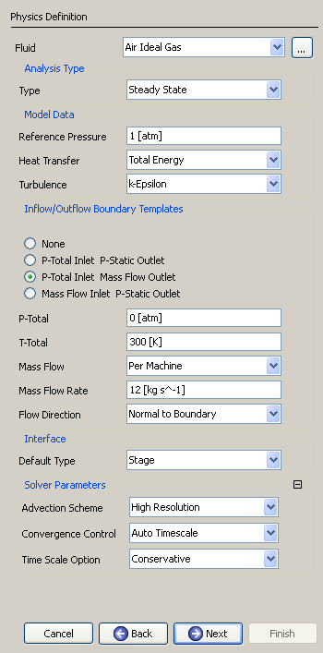
CFX-Pre Turbo Mode
Physics Definition
  Fluid properties
  Steady State vs. Transient
  Model Data
    Energy and Turbulence Models
  Boundary Templates:
    Pt inlet - Ps outlet
    Pt inlet - mass flow outlet
    Mass flow inlet – Ps outlet
  Interface Type:
    Stage, Frozen Rotor, Transient Rotor Stator
  Solver parameters
    Advection Scheme
    Time Scale/Step controls

Slide 8
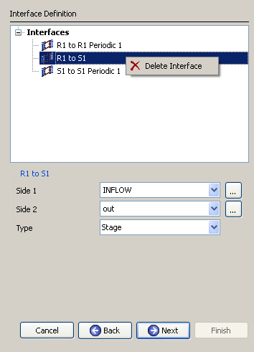
CFX-Pre Turbo Mode
Interface Definition
  Domain interfaces automatically generated!
  Setup/check all Domain Interfaces
    Frozen rotor
    Transient rotor stator
    Stage
    Periodic
    None
  Right-click to add or delete interfaces

Slide 9
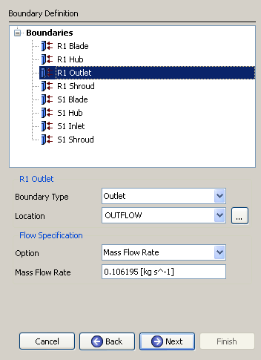
CFX-Pre Turbo Mode
Boundary Definition
  Boundary regions and conditions automatically setup!
  Define/check boundary conditions
  Right-click to add or remove boundary conditions

Slide 10
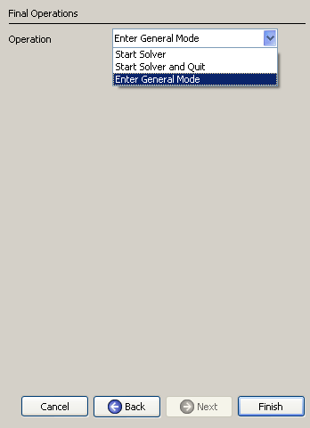
CFX-Pre Turbo Mode
Final Operations
  Options:
    Enter General Mode to make further operations
      Ex. Create monitor points
      Ex. Setup a multi-configuration run
    Write .def file and start the solver
      Option to quit CFX Pre

Slide 11
CFX-Pre Turbo Mode
Summary – six steps to setup a turbomachinery simulation:
  Basic Settings
  Component Definition
  Physics Definition
  Interface Definition
  Boundary Definition
  Final Operation
Advantages:
  Rapid setup for turbomachinery simulations
  Automatic creation of domain interfaces and boundary definitions

Slide 12
CFX-Pre General Mode
After the case has been set up in Turbo Mode, the following modifications can be made in general mode:
  Component mesh or case reload
  One to One connections for periodic and stationary domain connections can be specified directly
  Domain interface intersection control
  Creation of monitor points and/or source points
  Multi-configuration simulation
  Execution control

Slide 13
Turbo Post

Slide 14
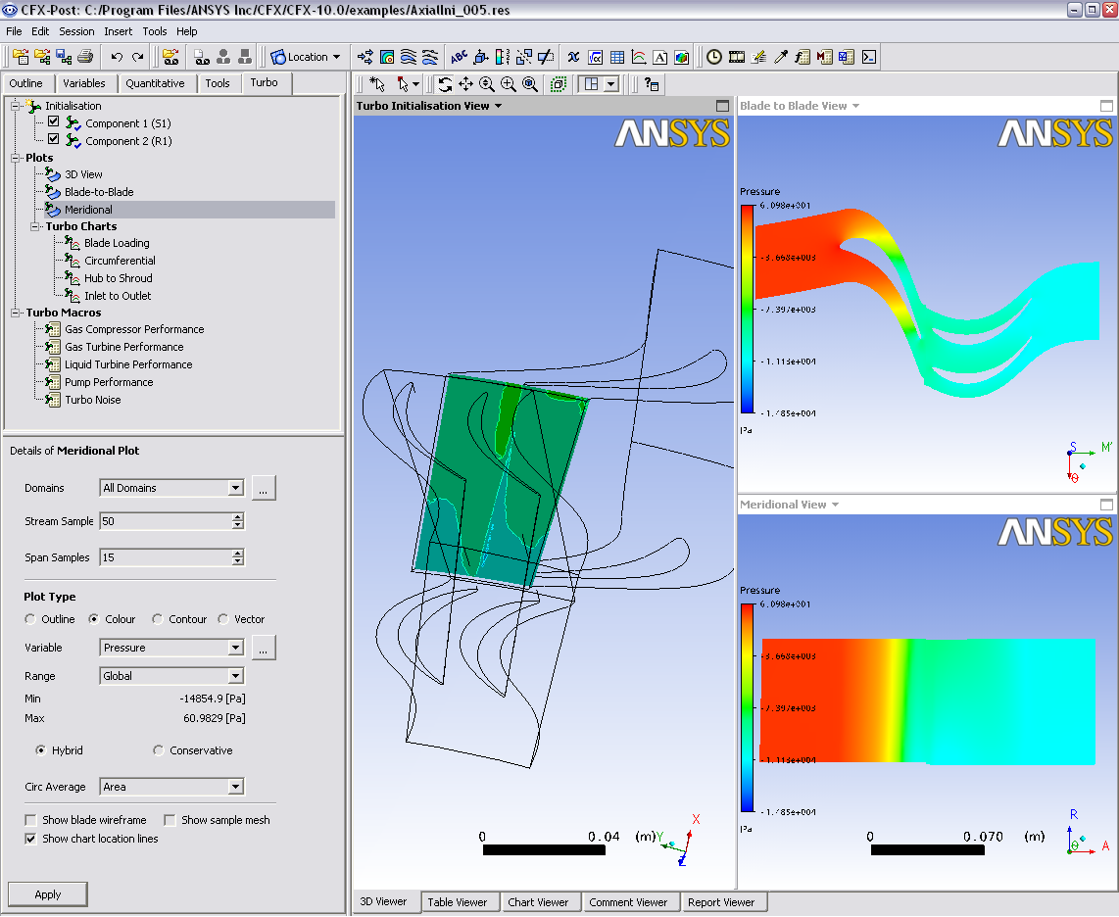
CFD-Post Turbo Workspace
The Turbo workspace improves and speeds up post-processing for turbo machinery simulations
  All Turbo post-processing performed on the Turbo tab

Slide 15
CFD-Post Turbo Workspace
The Turbo workspace:
  Creates span, m’, axial, radial and theta coordinate frames
  Allows users to visualize components in turbo space
  One-button calculation of velocity components (such as circumferential, radial, axial, meridional)
  Quickly generate turbo related charts and graphs
  Provides access to turbo specific macros
Works with Fluent or CFX results

Slide 16
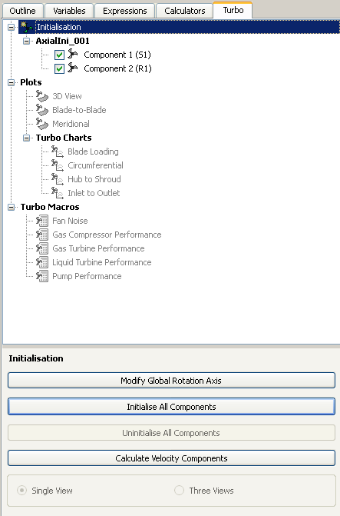
CFD-Post Turbo Workspace
Initialization
  Input required to create background mesh
  Specify number of instances to visualize full geometry
Options
  Automatic Initialization
  Manual Initialization
    User selects hub, shroud, blade, inlet, outlet, and periodic surfaces
  Calculate Velocity Components
    Ex. Radial, Tangential, and Meridional velocity components

Slide 17
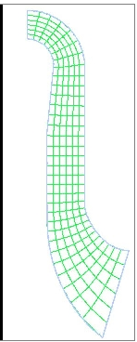
CFD-Post Turbo Workspace
Background Mesh
  Necessary to calculate streamwise (m’) and spanwise coordinates
  2D mesh formed by collapsing hub, shroud, inlet and outlet on to an axial-radial plane
  Outline is filled with mesh consisting of constant span and m’ lines

Slide 18
CFD-Post Turbo Workspace
Four types of objects are available that are useful for turbo machinery applications
  3D View
  Blade-to-Blade
  Meridional
  Turbo Charts

Slide 19

CFD-Post Turbo Workspace
3D View Plot
  Can select which parts to draw
    Optionally with mesh lines
  Show Blade-to-Blade plot in 3D view
  Show chart location lines
  Instancing

Slide 20
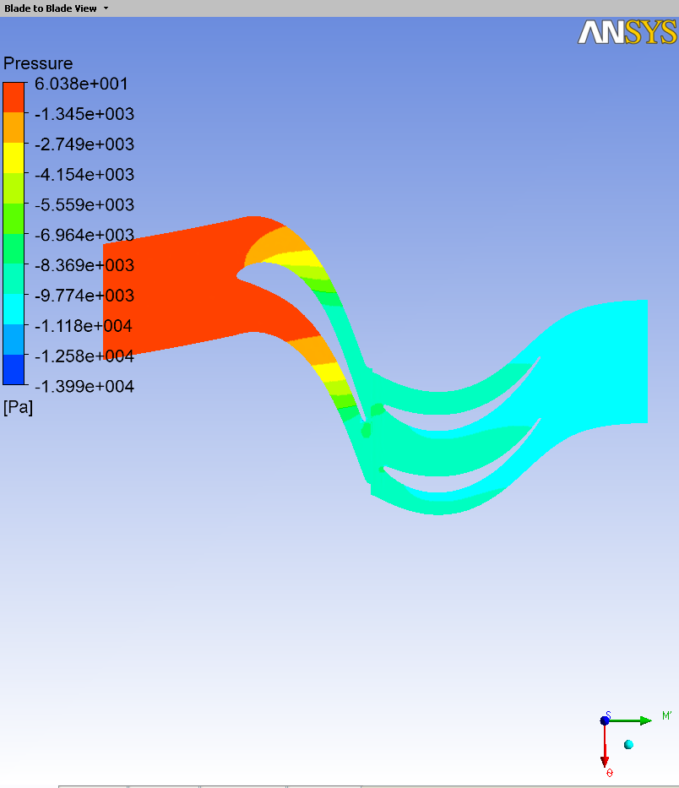
CFD-Post Turbo Workspace
Blade-to-Blade Plot
  Select Span
  Can generate the following plots:
    Colour
    Contour
    Vector
    Streamlines

Slide 21
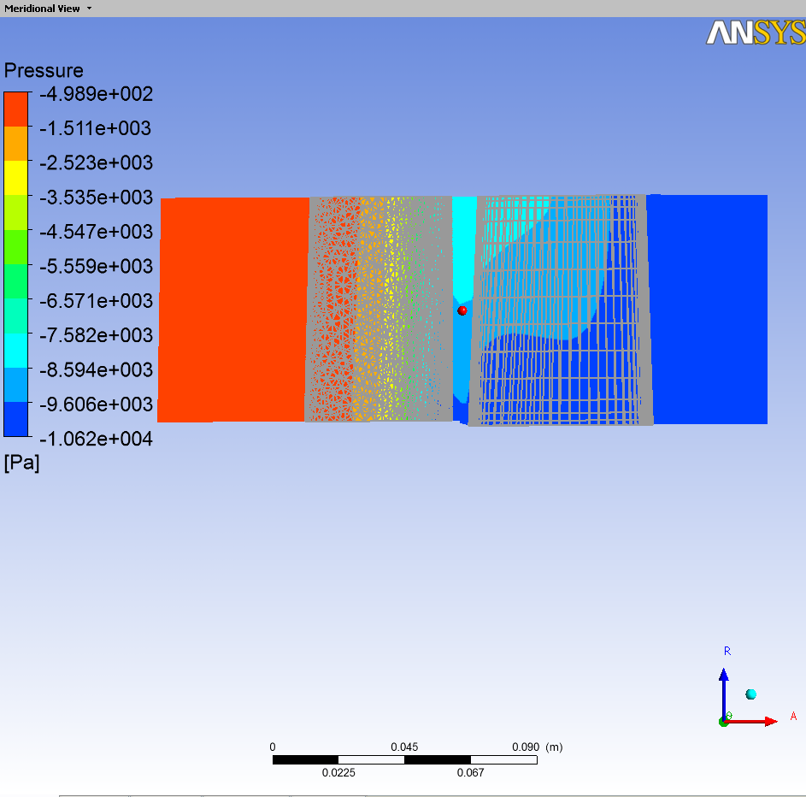
CFD-Post Turbo Workspace
Meridional Plot
  Can generate the following plots:
    Outline, Colour, Contour, Vector
  Different types of circumferential averaging
    None, length, area, mass
    Refer to help documentation for more details

Slide 22
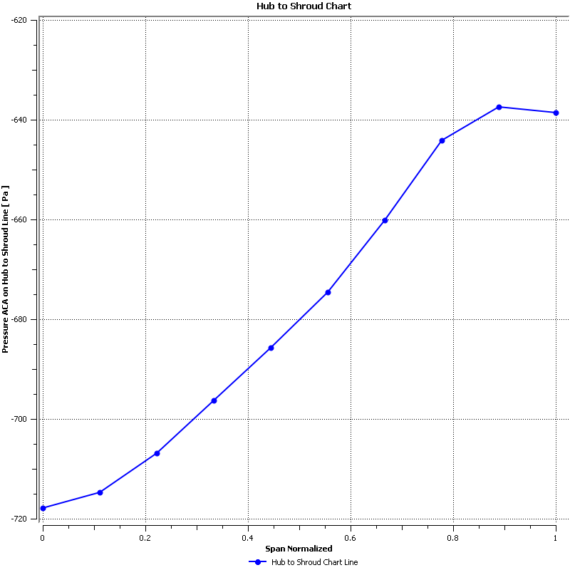
CFD-Post Turbo Workspace
Turbo Chart
  Select one of the following chart types:
    Blade Loading
    Circumferential
    Hub to Shroud
    Inlet to Outlet
  Based on the chart type, user many need to input:
    X and Y axes variables
    Spanwise and/or streamwise location
    Number and distribution of sampling points
    Select the type of circumferential averaging

Slide 23
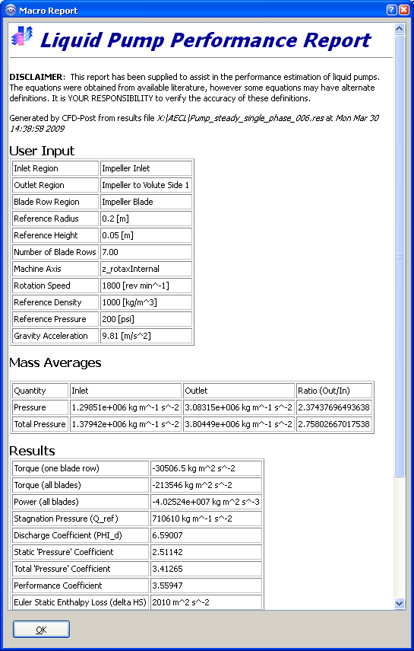
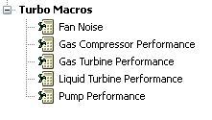
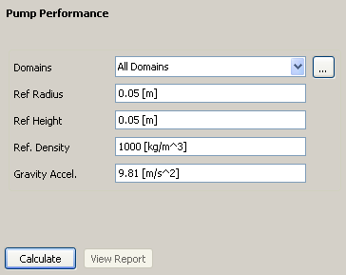
CFD-Post Turbo Workspace
Turbo Macros
  Four predefined macros
    Fan Noise
    Gas Compressor Performance
    Gas Turbine Performance
    Liquid Turbine Performance
    Pump Performance
  Modify input requirements as necessary
  Generates a report in .html format
    Calculates relevant quantitative data

Slide 24
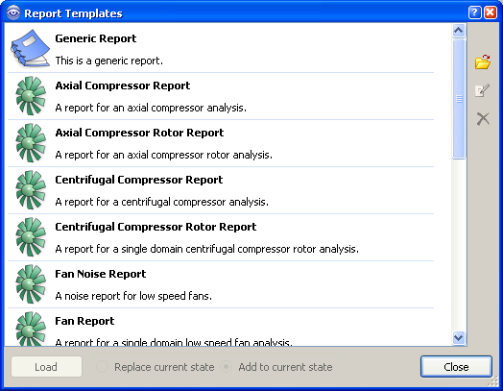
CFD-Post Turbo Workspace
Turbo Reports
  The turbo reports are designed for single and multiple blade row fluid analyses
  Turbo reports attempt to auto-initialize Turbo mode
    If auto-initialization fails, user must initialize Turbo mode manually and re-run the turbo report

Slide 25
CFD-Post Turbo Workspace
Turbo Post
  Automated initialization of components
  All turbo post objects are presented in a single encapsulated interface
  Turbo Post graphical objects can be promoted to full post processing mode for general use if desired
    Done by right clicking on turbo object
Additional Tools in CFD Post
  Tables can be created
  Multiple cases can be loaded and compared
    Generation of performance curves
  Turbo Surfaces and Turbo Lines can be created in General Mode

Slide 26
Key Point
Turbo-Pre
  Facilitates setup of rotating machinery problems
Turbo-Post
  Provides additional functionality in CFD-Post to add powerful post-processing capabilities for turbo cases
For Practical Examples:
  Axial Fan Workshop
  Tutorial # 12

